Slide 1
Domicology:
A
Comprehensive Approach to
Structural Abandonment
Rex L. LaMore, Ph.D.
MSU Center for Community and Economic Development
&
Urban and Regional Planning Program
George H. Berghorn, Ph.D.
MSU Construction Management Program
&
MSU Department of Forestry
https://domicology.msu.edu/

Slide 2
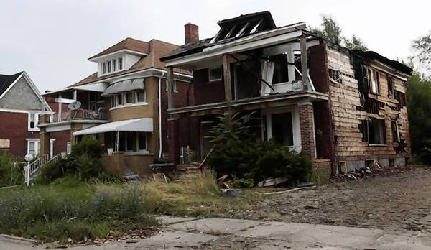
Structural Abandonment in the United States
Residential Properties Vacancy
7.4 million homes are currently vacant and not being marketed for sale or rent in 2012
  (The Joint Center for Housing Studies of Harvard University).
~40% of the nation’s vacant homes are located in just 10% of all census tracts
  (Duke 2012).
Source: http://articles.chicagotribune.com/2013-07-24/news/sns-rt-us-usa-detroit-blight-20130724_1_blight-removal-blight-problem-urban-blight

Slide 3
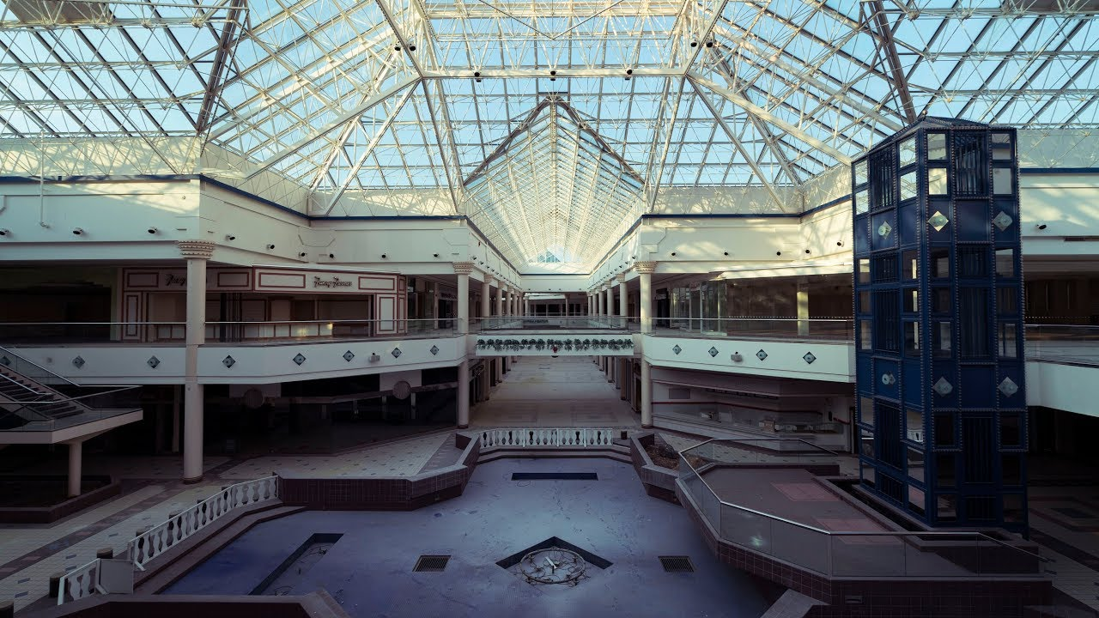
Structural Abandonment in the United States
Commercial Properties Vacancy
>two dozen malls have shut down in the last four years and another 60 malls are on the brink.
  (New York Times Report)
36% of commercial properties are vacant in Detroit, Michigan as estimated.
  (Detroit Works Project 2012)
Source: https://www.youtube.com/watch?v=QmNyVFibClQ

Slide 4
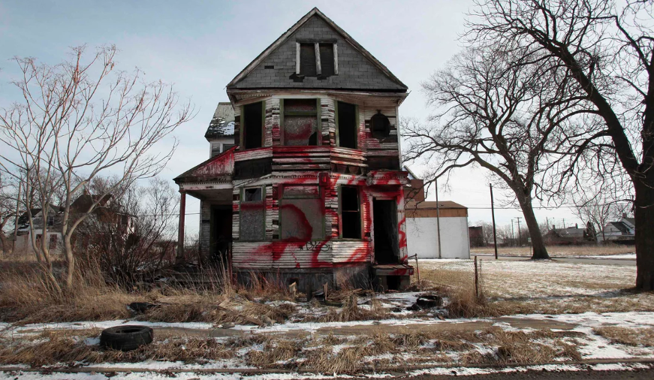
Vacant Properties: The True Cost to Communities
Austin, TX:
blocks with vacant buildings compared to blocks without:
  3.2x drug calls
  2x violence calls
  1.8x theft calls
St. Louis, MO:
has spent $15.5M, or $100 per household, on vacant building demolition in the past 5 years.
Philadelphia, PA:
found a $7,627 net loss in value for houses within 150 feet of a vacant or abandoned property in a 2001 study.
spends $1.8M per year cleaning vacant lots.
Detroit, MI:
spends $800k per year, on vacant building demolition.
United States:
>12,000 fires break out in vacant structures each year in the US.
  Resulting in $73M property damage annually.
  Most are the result of arson.
Source: https://www.theguardian.com/cities/2014/apr/03/the-death-of-a-great-american-city-why-does-anyone-still-live-in-detroit

Slide 5

Costs to Homeowners
Higher Insurance Premiums
  Proximity to vacant/abandoned properties makes obtaining homeowner’s insurance, mortgages, and loans for home improvement more difficult.
    Insurance companies pay attention to neighborhood dynamics.
Poorer Quality of Life
  Abandoned buildings = social fragmentation
    Feelings of isolation weaken the community.
  Large numbers of vacant buildings symbolize that no one cares.
    Increases likelihood that property values will continue to decline, resulting in further abandonment.
  Aesthetic impact of abandoned properties
    Not easily quantified in dollars
Source: https://www.vectorstock.com/royalty-free-vector/money-eye-house-character-cartoon-style-vector-17877149

Slide 6
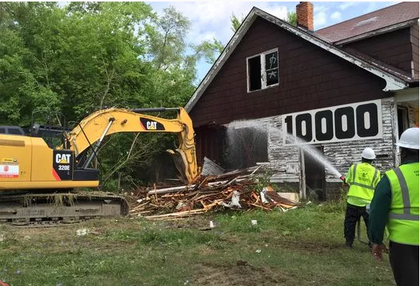
Health Impacts
Industrial and commercial sites may contain other contaminates.
  There are approximately 450,000 sites considered brownfields in the U.S.
Lead and asbestos are highly dangerous health and safety hazards and found in many older structures.
  Lead can cause lifelong learning and behavioral problems in children if they are exposed at a young age. Asbestos is a carcinogen.
  Demolition can produce large amounts of ambient lead and asbestos dust.
  Pre-removal of asbestos by certified workers is often required (increases cost of demolition and deconstruction)
Demolition done using a “wetting” process can reduce these hazards, but does not eliminate lead dust completely
Wet demolition on the 10,000th Detroit demolition from the Detroit Blight Removal Task Force.
Source:https://www.freep.com/story/news/local/michigan/detroit/2016/07/19/detroit-reaches-blight-milestone-10000-demolitions/87284392/
Notes:
It can be associated with deconstruction and demolition activities. It is commonly found in paint, water pipes, and some fixtures. Homes built before 1978 have an increased chance of lead-based paint.
Dust from lead can be ingested or inhaled, and it only takes about the equivalency of three granules of lead dust to cause significant and irreversible brain damage in young children (Thompson, 2014).
Lead dust can also remain present after work activities have been completed, and can then be blown into homes or picked up on shoes (Thompson, 2014).

Slide 7
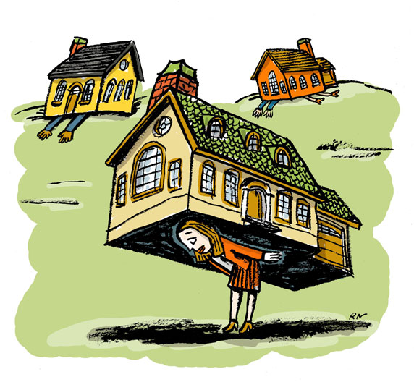
Economic Impacts
The removal of all the currently estimated abandoned residential properties (7.4 million) could cost over $88 billion dollars (not including brownfield remediation costs).
  The full cost of demolishing an average residential property is around $12,619 (City of Detroit-Blight Taskforce, 2016).
Abandoned properties inherently decrease the tax revenues available to public entities to support public safety, debt retirement, public works maintenance and other critical social needs.
  Local government financial stress due to loss revenues.
Source: https://www.nytimes.com/2009/09/12/your-money/mortgages/12money.html

Slide 8
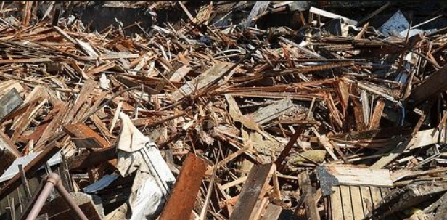
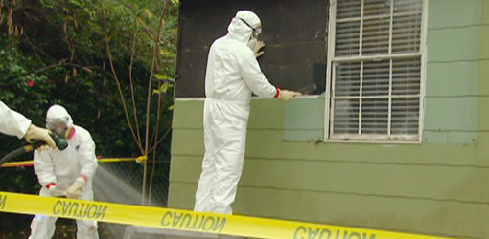
Environmental Impacts
    Construction & Demolition waste (US EPA)
  136 million tons generated each year
  ¼ of all landfill waste
  650 shipping containers/3months (DLBA 2019)
Hazardous materials
  Increase the potential for public health concerns
  Substantially increasing the public costs of demolition and clean up
Source: https://www.cityofpacificgrove.org/living/green-pg/solid-waste-recycling/solid-waste-recycling-information-business/debris-recycling
Source: https://www.todayshomeowner.com/video/how-to-remove-and-dispose-of-asbestos-siding-and-roofing/

Slide 9
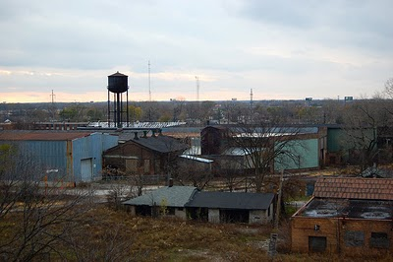
Environmental Impacts
It is estimated that there are more than 450,000 brownfields in the U.S.
  Cleaning up and reinvesting in these properties increases local tax bases, facilitates job growth, utilizes existing infrastructure, takes development pressures off of undeveloped, open land, and both improves and protects the environment.
As 2016, there were 1,328 Superfund Sites listed
  Michigan has 65 on the National Priority List
    https://www.epa.gov/superfund/national-priorities-list-npl-sites-state#MI
Source: http://greatlakesecho.org/2017/03/13/environmentalists-wonder-about-impact-of-michigan-brownfield-bills/
Notes:
- C&D materials consist of debris generated during the construction, renovation, and demolition of buildings, roads, and bridges. Cement concrete comprises the majority of C&D waste by weight, 67% in 2013, followed by asphalt concrete (18%) and wood products (8%).
- The reduction of C&D waste production through increased recycle and reuse rates could conserve landfill space and reduce the environmental impact associated with the extraction and consumption of new resources and production of new materials (EPA, 2016).
- Michigan landfill capacity taken from DEQ report on Solid Waste Landfilled in Michigan Feb 2017

Slide 10
To summarize: current system of abandonment
Abandoned structure becomes blighted
A cycle of community decline is set in motion
Government is left with the burden of eliminating the structure
Taxpayers bear the cost of demolition and cleanup
Private owner constructs property
Owner abandons
the structure
Notes:
This chart represents the current system of private property abandonment in Michigan.
First the private sector constructs and industrial or commercial property, then in the event that they private sector experiences some form of economic hardship they “walk away” from the structure and it is left as a vacant structure in the community. If this structure is not sold or repurposed, as many are not, it becomes blighted and a threat to public safety.
When a community becomes littered with these abandoned and blighted properties the local governments are left with the burden of eliminating these structures, and ultimately it is the general tax paying public that bear the cost of deconstruction. Which sets in motion general blight and decline.

Slide 11

WHO PAYS FOR THIS ?
  YOU DO!
    In general, when no responsible party can be held accountable, the taxpayer pays for blight removal and contaminated site clean up.
    For example in brownfield redevelopment the public foregoes future tax revenues to finance cleanup.
    In superfund sites (the really dangerous places) we also pay just to remove the toxic materials

Slide 12
Summary of structural abandonment
NOT GOOD for people and places:
It presents clear health and safety hazards
It is expensive and we are paying for it
It is an unsustainable use/abuse of resources
This is our issue!
SO WHY DO WE ALLOW IT?

Slide 13
A New Structural Paradigm
Recognize that the built environment:
Has a life cycle
Plan, design, construct, use, reuse & deconstruct with this life cycle in mind
Develop public policies to provide financial assurances that at the end of a structures useful life there would be the necessary resources to remove the structure
Support product development that reuses salvage materials
Support businesses that collect and sale these products
Encourage consumers to purchase these products where appropriate

Slide 14
The Alternative Paradigm
Owner constructs facility and anticipates end of useful life and designs accordingly
The parcel is returned to the original state
Blight and abandonment prevented!
Over time structure is used and reused
Consumer-occupant assumes cost of deconstruction
NOT GENERAL TAXPAYER!
Structure is deconstructed with funds from the bond/insurance
Notes:
This chart represents the current system of private property abandonment in Michigan.
First the private sector constructs and industrial or commercial property, then in the event that they private sector experiences some form of economic hardship they “walk away” from the structure and it is left as a vacant structure in the community. If this structure is not sold or repurposed, as many are not, it becomes blighted and a threat to public safety.
When a community becomes littered with these abandoned and blighted properties the local governments are left with the burden of eliminating these structures, and ultimately it is the general tax paying public that bear the cost of deconstruction. Which sets in motion general blight and decline.

Slide 15
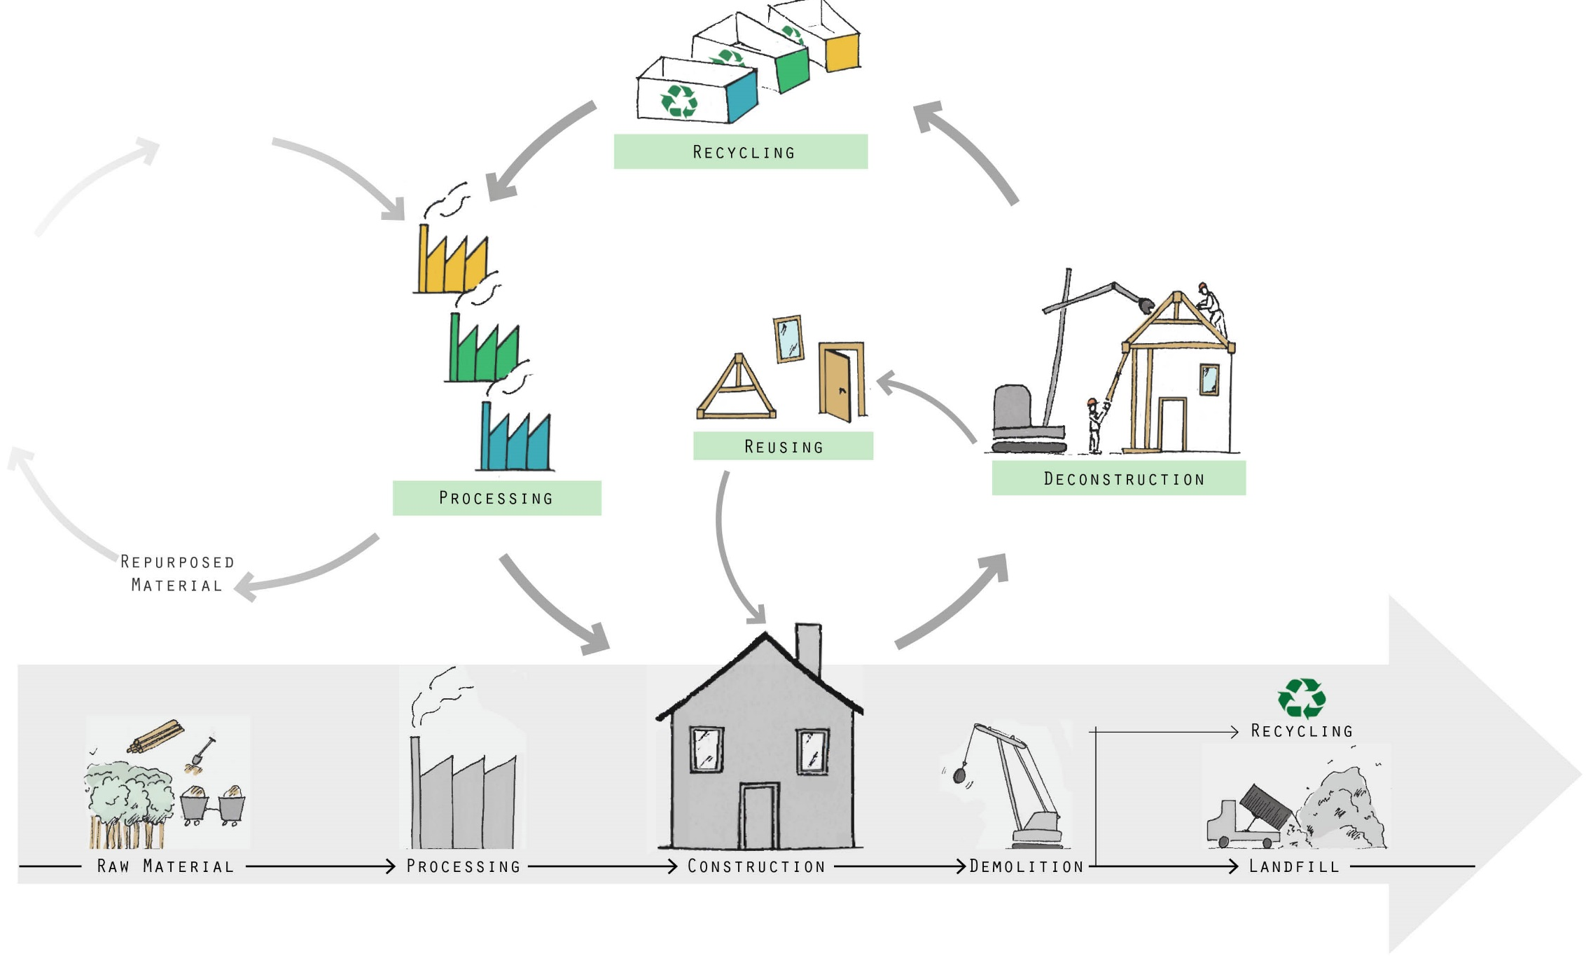
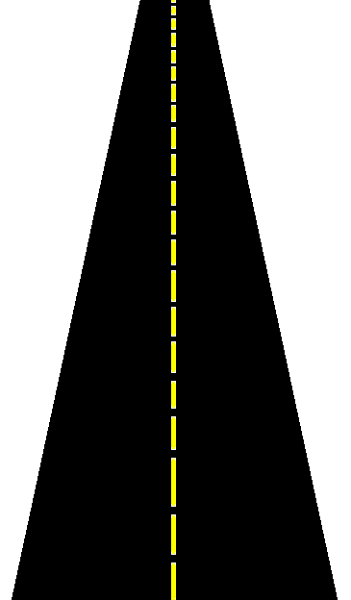
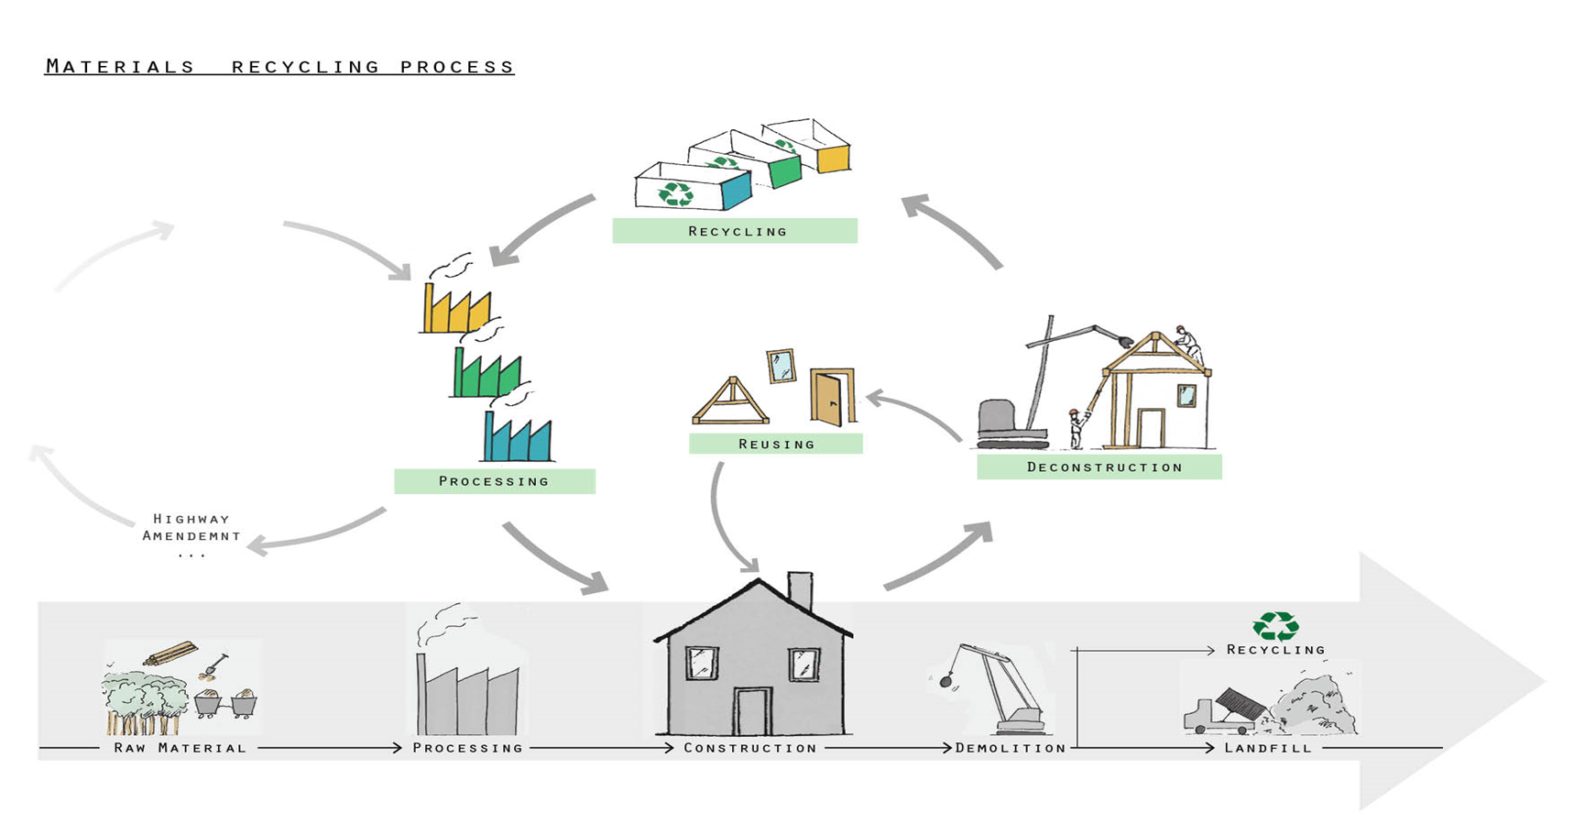
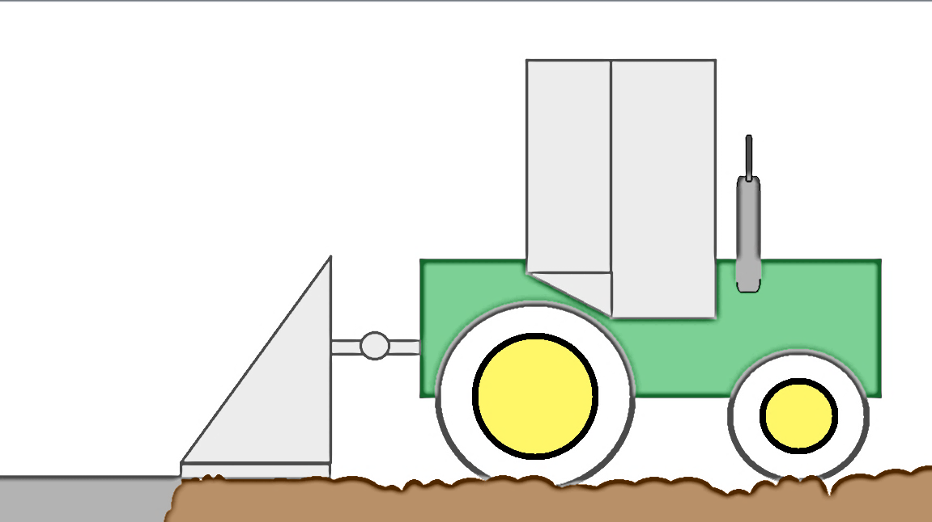
New Structural Paradigm:
Circular Built Environment Ecosystem
Recycling
Reusing
Processing
Deconstruction
Repurposed Material
Raw Material
Processing
Construction
Demolition
Landfill
Notes:
This chart represents the current system of private property abandonment in Michigan.
First the private sector constructs and industrial or commercial property, then in the event that they private sector experiences some form of economic hardship they “walk away” from the structure and it is left as a vacant structure in the community. If this structure is not sold or repurposed, as many are not, it becomes blighted and a threat to public safety.
When a community becomes littered with these abandoned and blighted properties the local governments are left with the burden of eliminating these structures, and ultimately it is the general tax paying public that bear the cost of deconstruction. Which sets in motion general blight and decline.

Slide 16
Domicologists:
  Recognize that manmade structures have a life cycle.
  Examine the life cycle continuum of the built environment and plan, design, construct, and deconstruct.
    Maximize the reuse of materials and minimize the negative impacts of a structure's end of useful life
  Identify innovative tools, models, policies, practices, and programs that can sustainably address a structural life cycle.
  Conduct research on the technical, economic, and policy challenges present in a structure's life cycle and seek to reduce the negative social, economic, and environmental impacts associated with structural abandonment.
  Support a circular structural economy that creates jobs for vulnerable people and forms new business in distressed places.

Slide 17
Welcome to the world of
Domicology
The study of the economic, social, and environmental characteristics relating to the life cycle of the built environment.

Slide 18
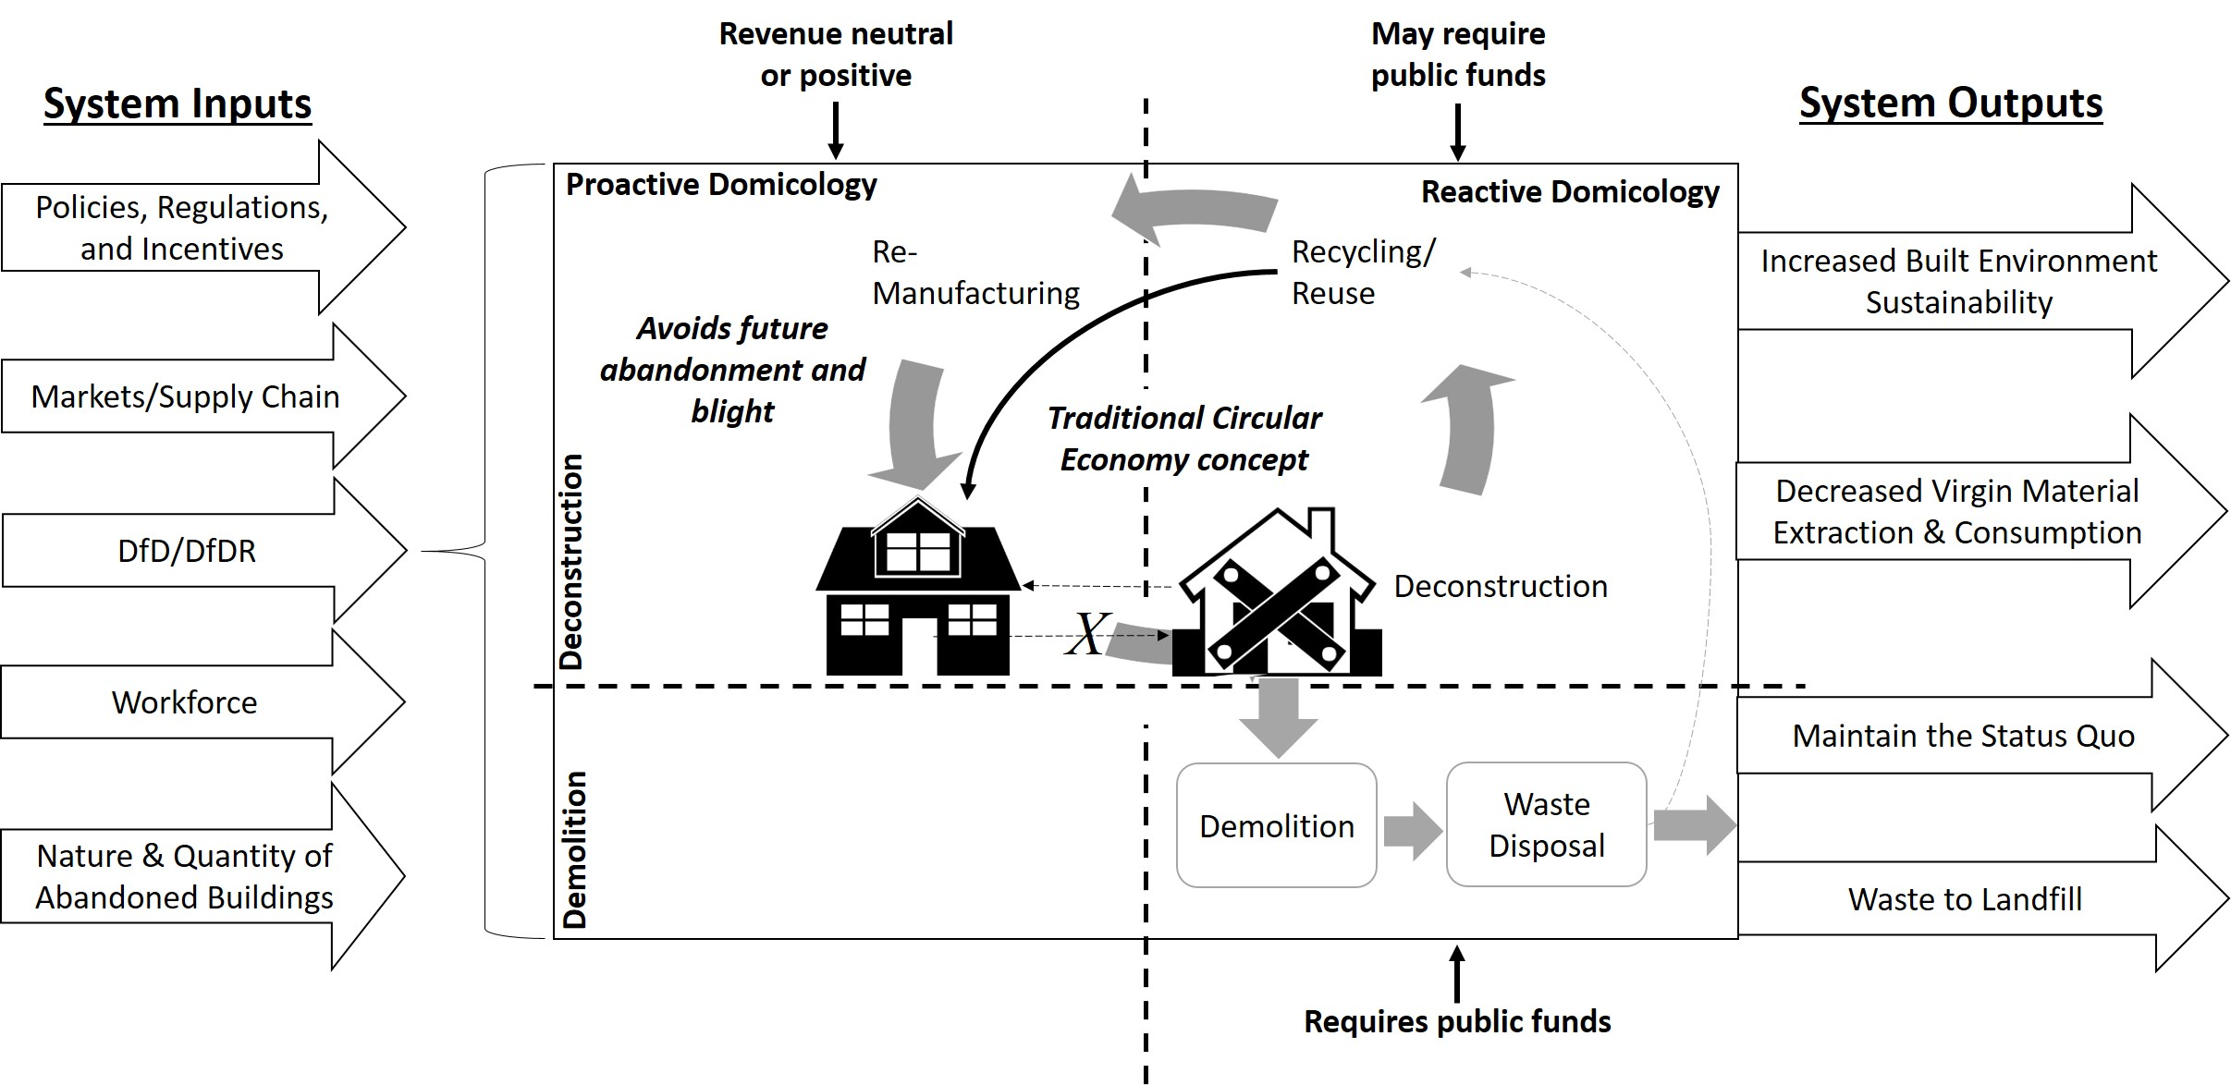
Domicology – A Look Through (Spartan)
Green Colored Glasses

Slide 19
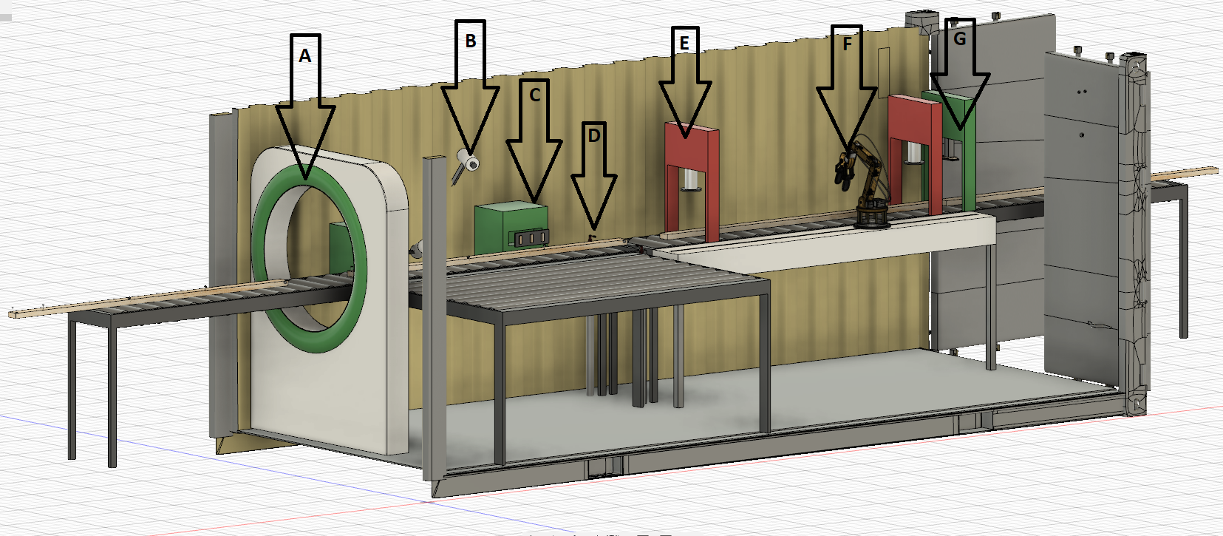
Domicology – Campus Context
    Outreach Opportunities
      Local Government
      Statewide Industry
      Entrepreneurship

Slide 20
Domicology – A Look Through (Spartan)
Green Colored Glasses
Community Context
Engagement with Detroit Land Bank Authority, Genesee County Land Bank (Flint), Ingham County Land Bank (Lansing), Muskegon County Land Bank
Opportunity to recruit non-traditional and underrepresented students as summer research assistants – Detroit and Jackson, MS
Abandonment is pervasive - Atlanta; Las Vegas; Wichita; Birmingham; St. Louis; Jacksonville; and Indianapolis are at or near the top

Slide 21
Domicology – A Look Through (Spartan)
Green Colored Glasses
Crosscutting impact of broader Domicology research topics
 | Focus areas
Research topic | Construction Management | Community & Economic Dev. | Civil Engineering | Urban & Regional Plng. | Human Rscs & Labor Rel. | Supply Chain Management | Other fields
1. Why abandonment happens |  | X |  | X |  |  | Anthropology, economics, public policy, psychology, sociology
2. Governmental policies, regulations, and incentives |  | X |  | X |  |  | Economics, public policy
3. Technological solutions | X |  | X |  |  | X | Chemical engineering, chemistry, electrical engineering, entrepreneurship, mechanical engineering, public health
4. Time and cost of demolition versus deconstruction | X |  |  |  |  | X | Industrial engineering
5. Design for Deconstruction and Reuse | X |  | X |  |  |  | Architecture, chemical engineering, chemistry, mechanical engineering
6. Market and supply chain management | X |  |  | X |  | X | Finance, management, marketing
7. Workforce skills and training | X | X |  |  | X |  | Adult education, educational psychology, entrepreneurship
    Content expansion and program growth
Source: Berghorn et al., 2019

Slide 22
Anthropology
Economics
Education
Human Resources
Political Science/Public Policy
Psychology
Sociology
Urban & Regional Planning
Entrepreneurship
Finance
Management
Marketing
Architecture
Chemistry
Construction Management
Engineering
Environmental Science & Sustainability
Material Science
Natural Resource Management
Supply Chain Management

Slide 23
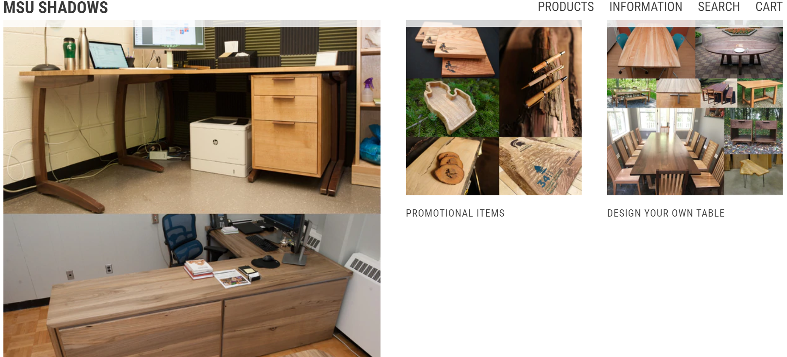
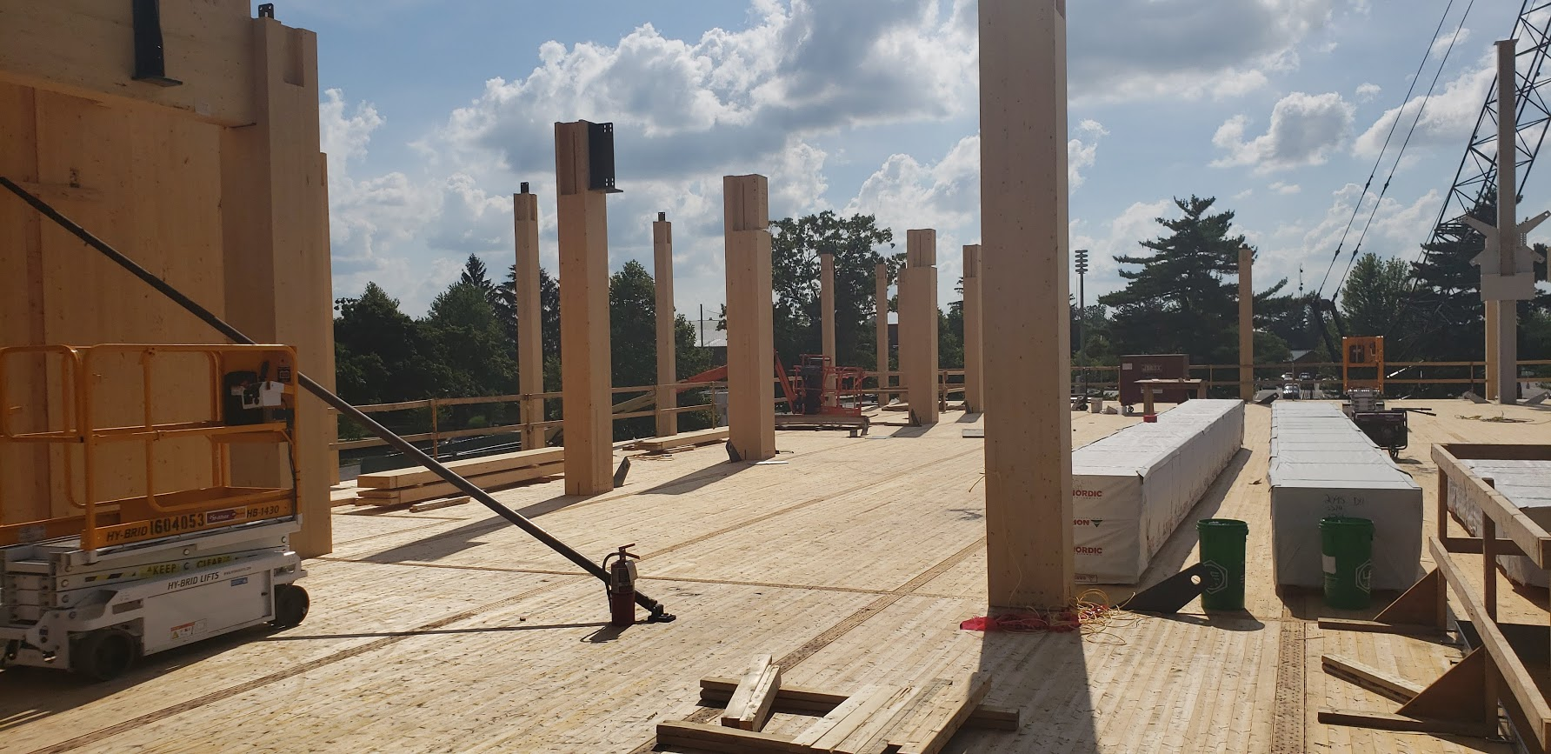
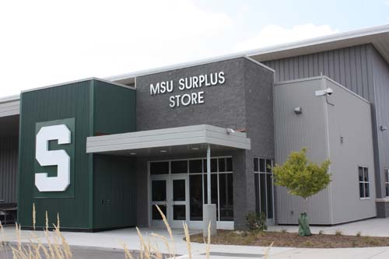
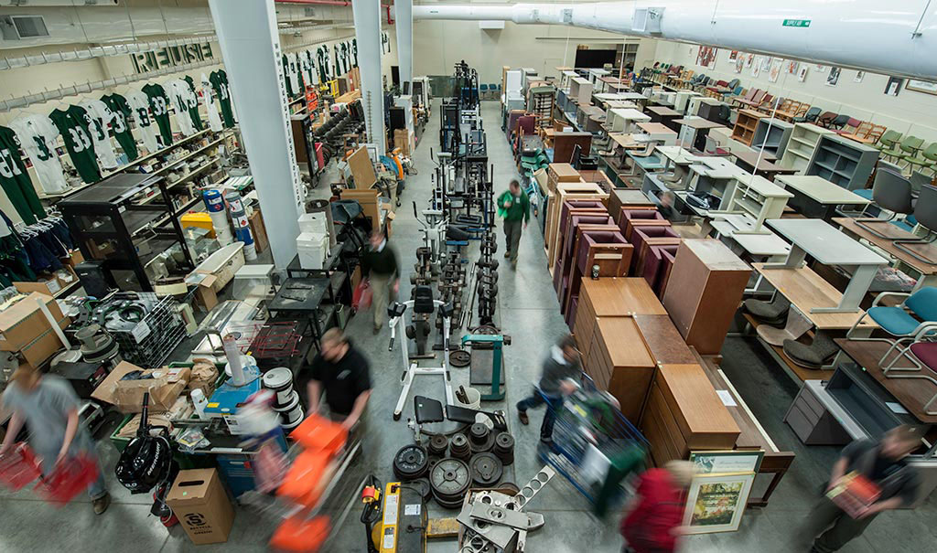
Domicology – A Look Through (Spartan)
Green Colored Glasses
    Leverage building code and “buy local” opportunities on campuses
    Support for new materials, design for deconstruction, and material salvage/reuse
    MSU Sustainable Wood Recovery Initiative
    Salvage facilities/C&D MRFs
Source: https://msushadows.com/

Slide 24
Domicology – A Look Through (Spartan)
Green Colored Glasses
    Teaching and Research
      Domicology course –significant research and outreach components
      Deconstruction time and cost
      Barriers to implementation
      Material research
      Policy
      Other

Slide 25
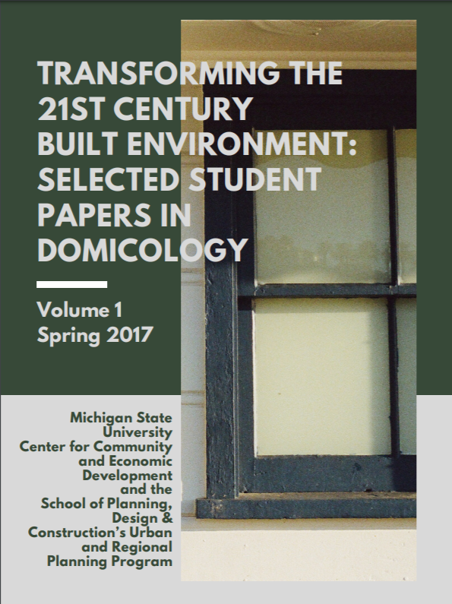
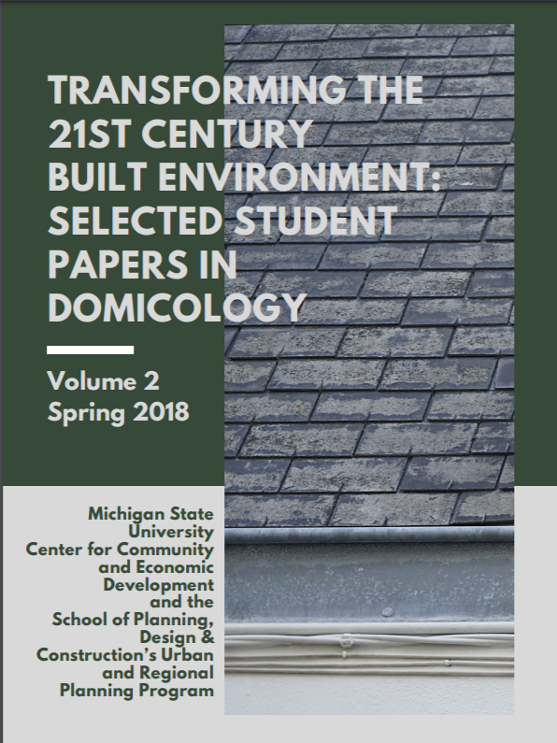
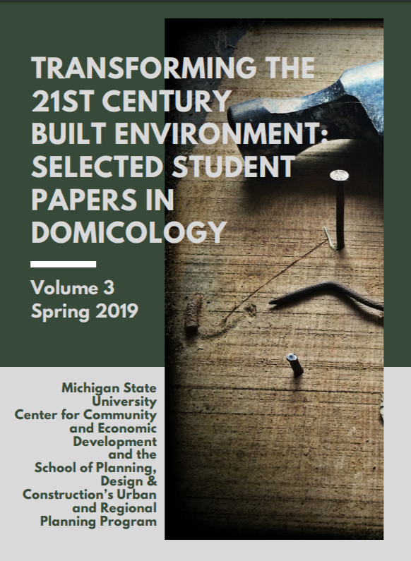

Slide 26
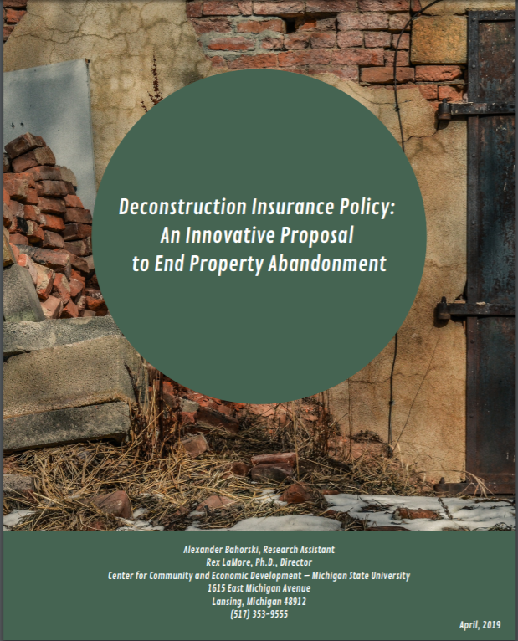
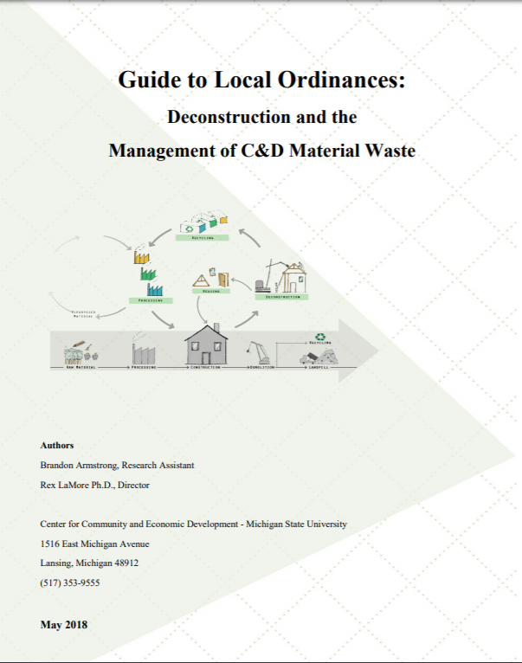
Domicology – A Look Through (Spartan)
Green Colored Glasses

Slide 27
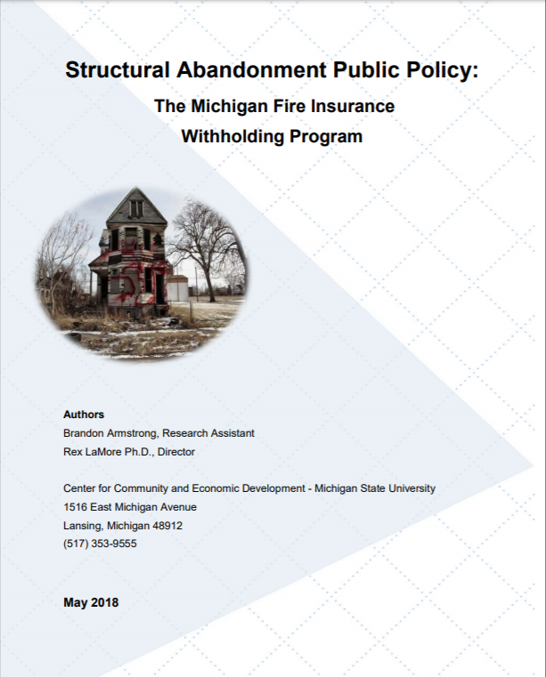
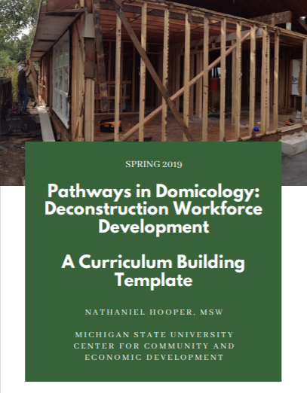
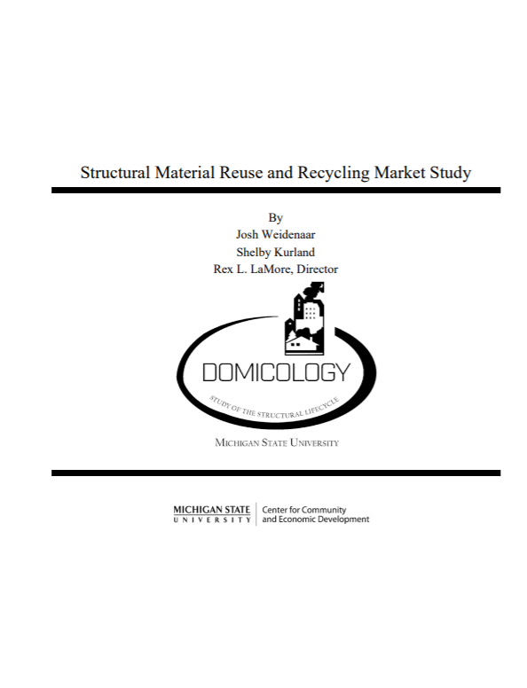
Domicology – A Look Through (Spartan)
Green Colored Glasses

Slide 28
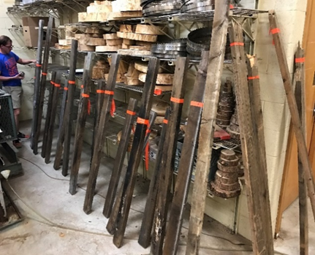
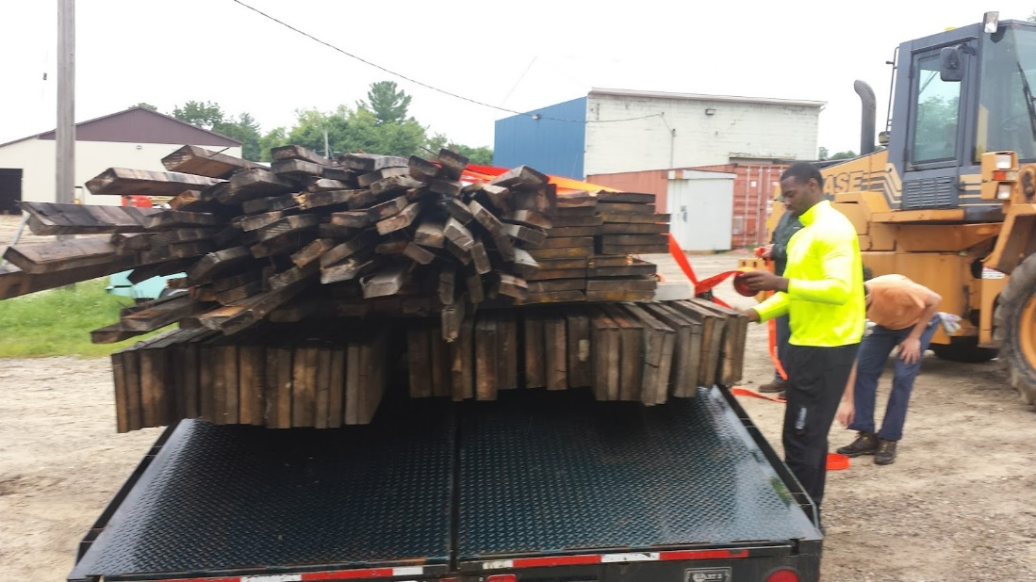
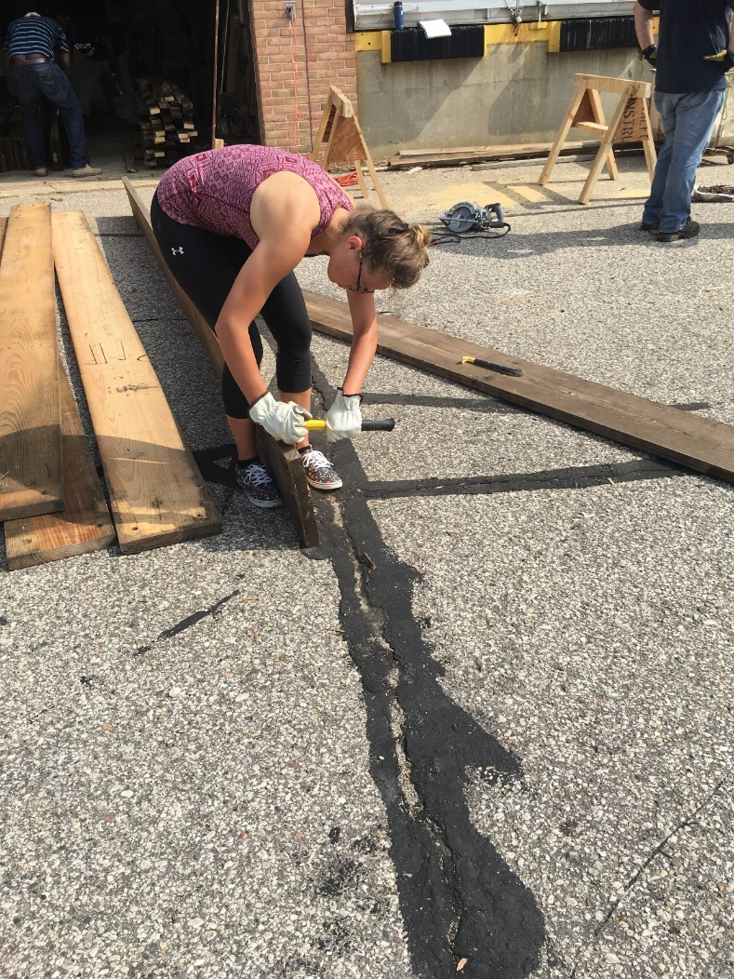
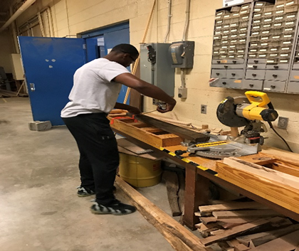
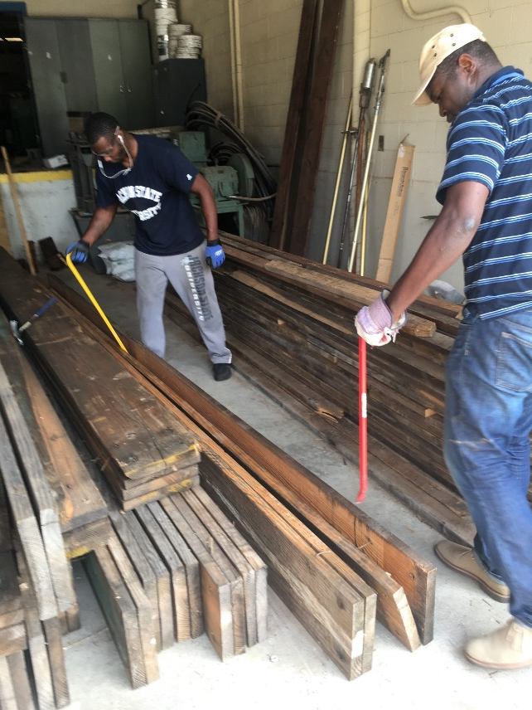
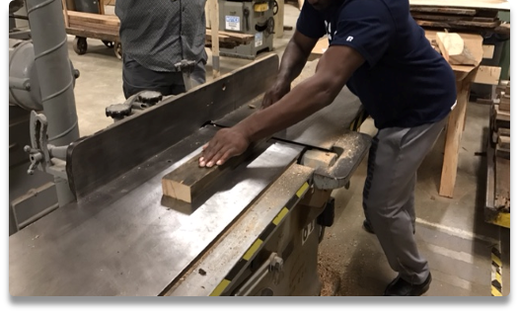
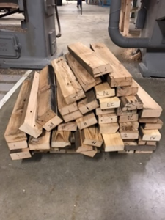

Slide 29
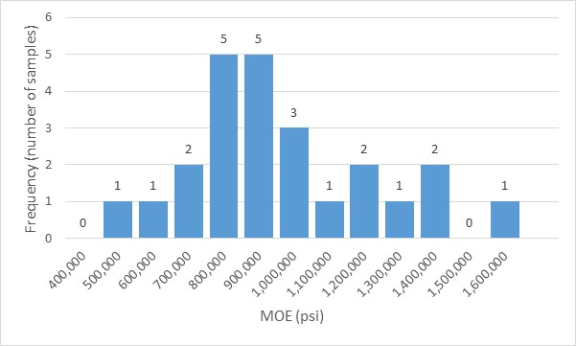
1902 Home – Larch Spp.
E3 Stress Class
25% of samples pass

Slide 30
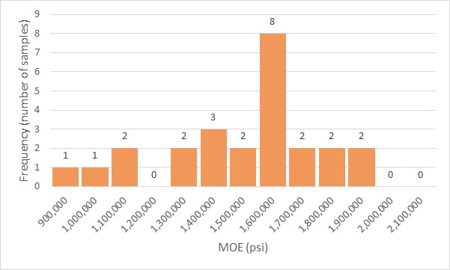
~1954 Home – Spruce and Pine Spp.
E3 Stress Class
84% of samples pass
Opportunities for residues & rejects?
Sound walls
Chips – hardboard, composites
Resin production
Biomass fuels

Slide 31
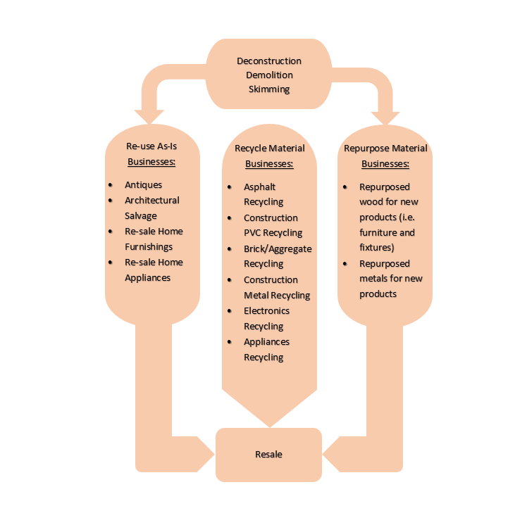
Structural Material Salvage and Reuse Innovation Hub:
Create a statewide salvage/reuse business accelerator that will provide strategic training, technical assistance and networking to improve the viability of this nascent industry sector and expand businesses’ recycling markets for salvaged materials.

Slide 32
Supporting a Training and Technical Assistance Network in Structural Materials Salvage and Reuse

Slide 33
Roles for Higher Education Institutions
As managers and owners of structures
  Practice material salvage and reuse
    Salvage sector facilities
    Use salvage materials in new construction
  Design for deconstruction
As educators
  Provide in key degree programs (CE, CM,UP, Architects others ) on structural material life cycle and material salvage and reuse
    Domicology 403
  Professional training and certification to practitioners
  Support field-based courses with key partners
As researchers
  Material salvage and reuse
  Public policy innovation—ending blight and abandonment

Slide 34
Questions or comments?

Slide 35


Thank You! Questions? lamore@msu.edu berghorn@msu.edu domicology.msu.edu

